Slide 1
Climate Change project update: week 3
Rens Breunissen,
Lotte van Dongen,
Markus Peschl,
Cecilia Casolo,
Maaike Elgersma,
Eva Slingerland,
Simon van Oosterom
Supervised by
Lorinc Meszaros [Deltares]
Robbert Fokkink [TU Delft]
Mathematical Data Science

Slide 2
Clustering, Neural Networks

Slide 3
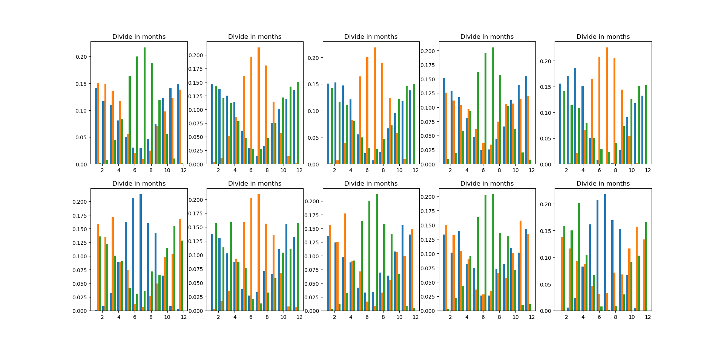
3) Clustering
Setup: standardized all variables, so gave all variables mean zero, variance 1. Next, applied Kmeans clustering for 1 station.
Fixed a bug that gave weird results.
Tried to see if clusters were different for different stations, wasn’t the case, see image on the right. This shows from left to right the clustering results for stations 1-5. Top shows clustering for first 10 years, bottom shows clustering for last 10 years.

Slide 4
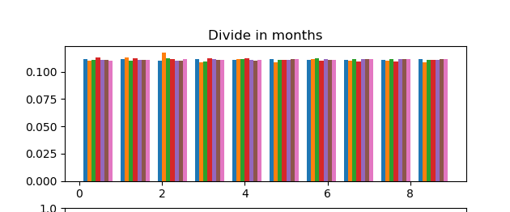
3) Clustering
Setup: standardized all variables, so gave all variables mean zero, variance 1. Next, applied Kmeans clustering for 1 station.
Fixed a bug that gave weird results.
Tried to see if we could cluster per station, wasn’t successful. Image shows the relative amount of points of each cluster, per station. Everything almost the same, as expected since data points between different stations don’t differ much, so clustering will most likely cluster based on seasons, and not on location.

Slide 5
Model prediction
Furthermore, we looked into the possibility of predicting the variables from one model based on the values from another model and a part of its own history.
First steps into multi linear regression were done, however the results will be shown next week.
Other methods used are neural networks and K-means

Slide 6
Other plots from the past weeks

Slide 7
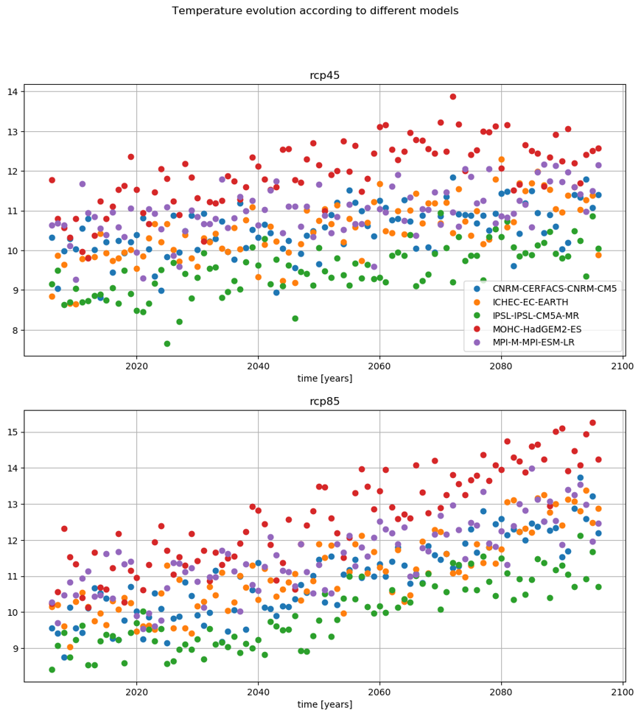
-) Temperature evolution
Yearly average of the temperature increases (obviously) for all models and scenarios.
Distribution of the temperature will be shown in the next slides

Slide 8
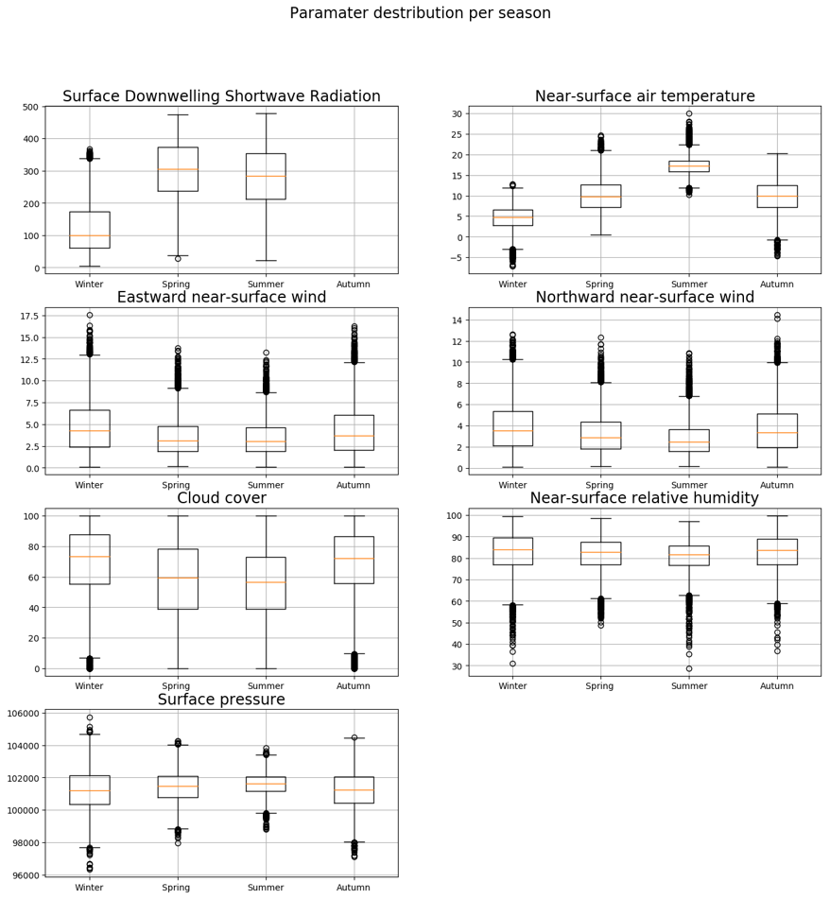
-) Evolution of the distribution of the variables
Boxplots of all variables aggregated over the whole time period

Slide 9
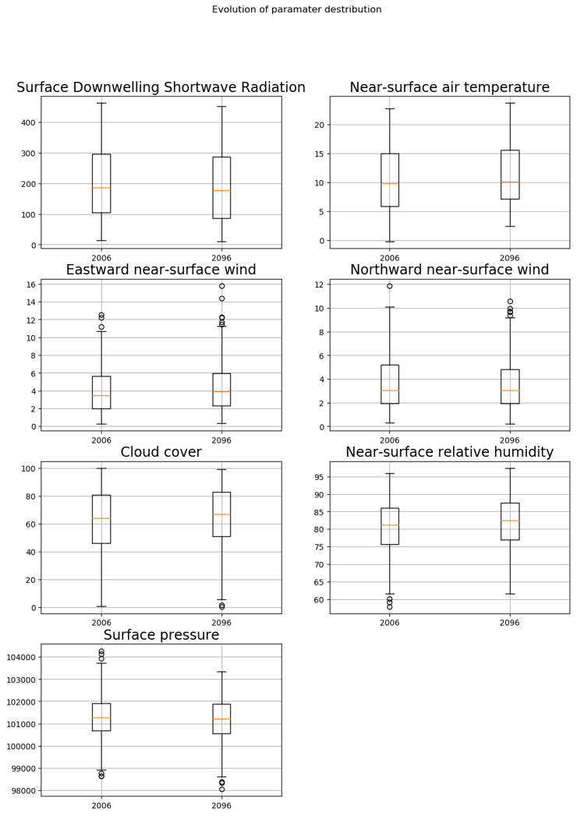
-) Evolution of the distribution of the variables
Comparing 2006 and 2096 as a whole

Slide 10
-) Evolution of the distribution of the variables
Idea: one year is still a relatively small period. As seen in point 3 (time-series plot) the average temperature fluctuates
So, this is the distribution of the variables over a period of 10 years, 2006-2016 and 2086-2096.

Slide 11
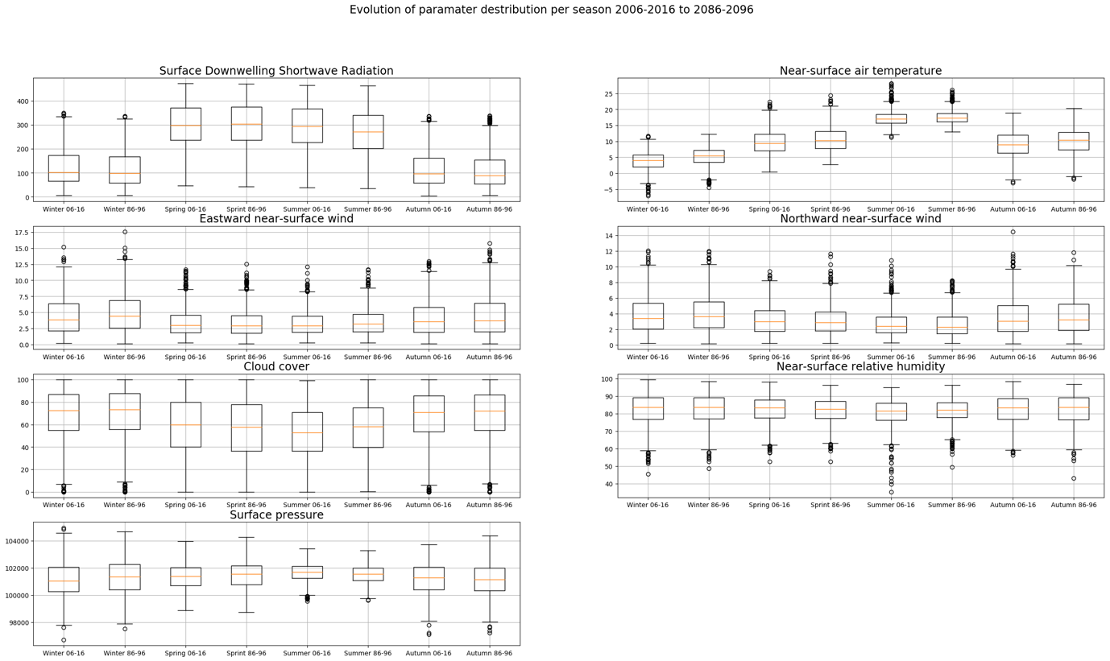
-) Evolution of the distribution of the variables
Idea: The yearly distribution hides seasonal variations in the parameters
So, give a boxplot of the distribution of the parameters per season and over a ten year period.
As can be seen, surprisingly, the temperature distribution in the first period is more spread out then in the last period.
Notice that the wind takes on only positive values?

Slide 12
Research questions

Slide 13
Options
See if we can correlate different variables, does this correlation change over the years/seasons?
See if we can cluster the points in different groups, do the characteristics of these clusters change over the years/seasons?
See if we can compare / correlate different prediction models and experiments, do they present similar characteristics? How can we describe differences between them?

